Slide 1
Program Management And Systems Engineering Direction Decisions of a Nanosatellite Mission
Aaron Goldstein
Program Manager

Slide 2
Overview
The Sun Devil Satellite Laboratory Overview
The Sun Devil Satellite 1 Overview
Overcoming Engineering Challenges on SDS-1
Approaching the Funding Problem
Summary and Current Status

Slide 3
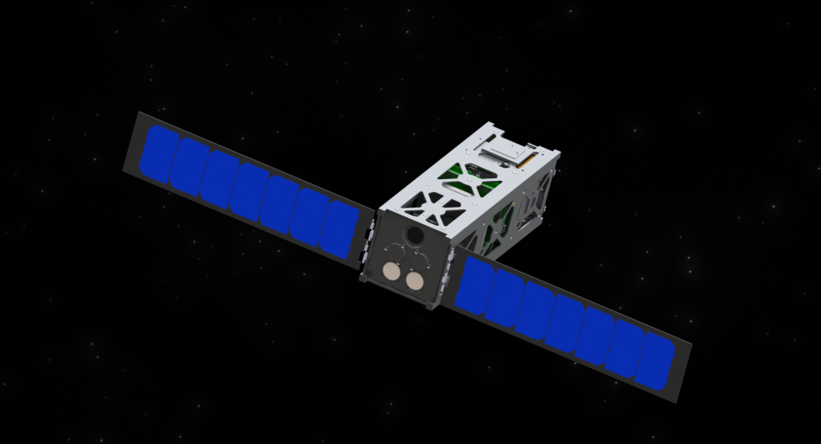
The Sun Devil Satellite Laboratory (SDSL) Overview
SDSL is a student-run organization
We build and promote university based satellite design
General Goals
Learn about space and spacecraft engineering…
Teach others about space and spacecraft engineering...
Current primary focus is the Sun Devil Satellite 1
The Sun Devil Satellite 1

Slide 4
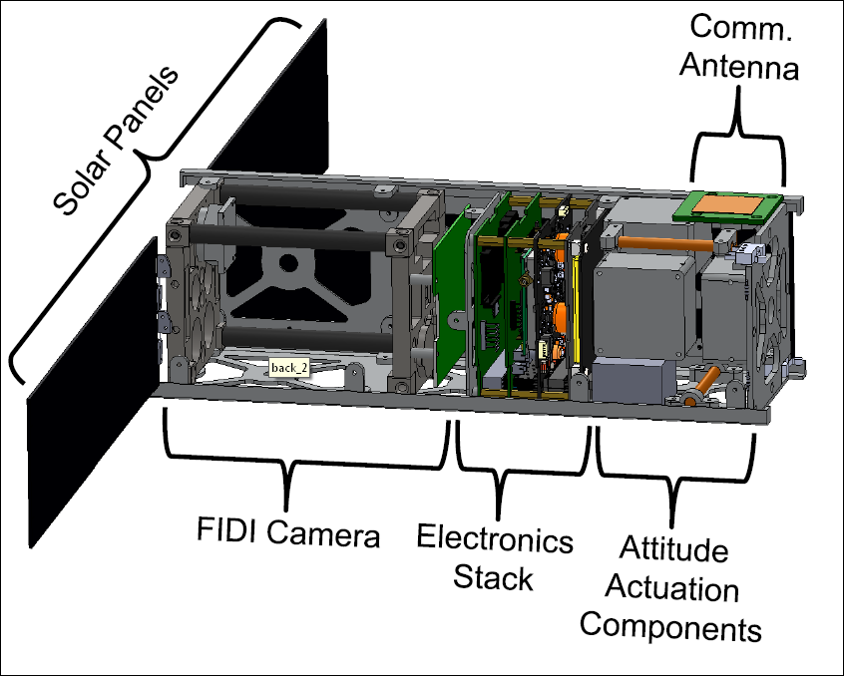
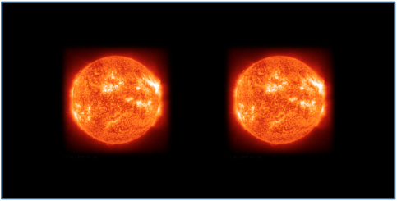
The Sun Devil Satellite 1 (SDS-1) Overview
CubeSat satellite mission to determine characteristics of solar flare initiation
Consists of two entities:
NASA Goddard Space Flight Center
The Sun Devil Satellite Laboratory
NASA GSFC will provide the payload:
the Flare Initiation Doppler Imager (FIDI)
SDSL will provide the satellite bus:
the Sun Devil Satellite 1
Operations:
the satellite will look at the sun, take pictures, correlating images taken with data from the Solar Dynamics Observatory (SDO)
SDS-1 + FIDI Cross Section Diagram
Sample FIDI Image

Slide 5
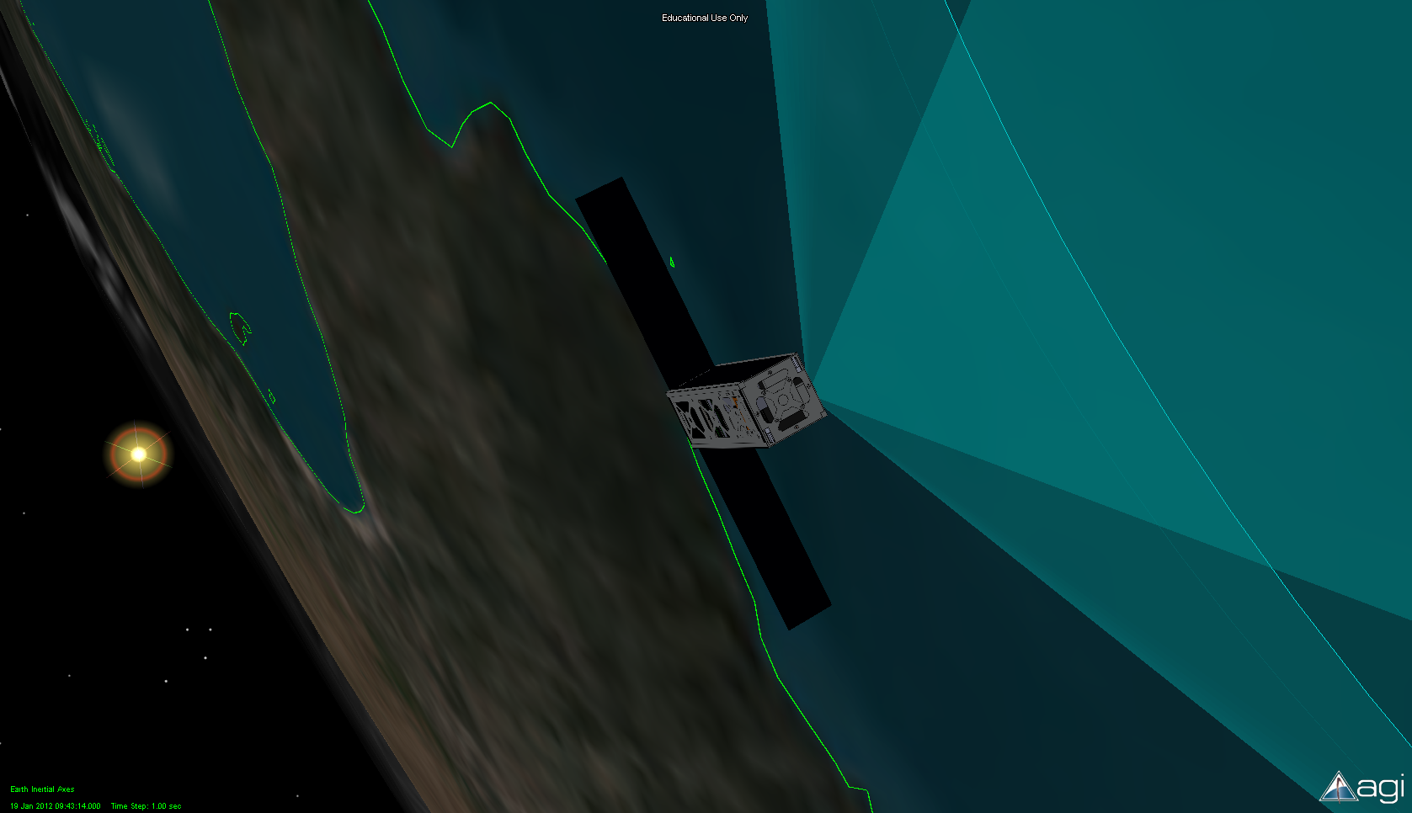
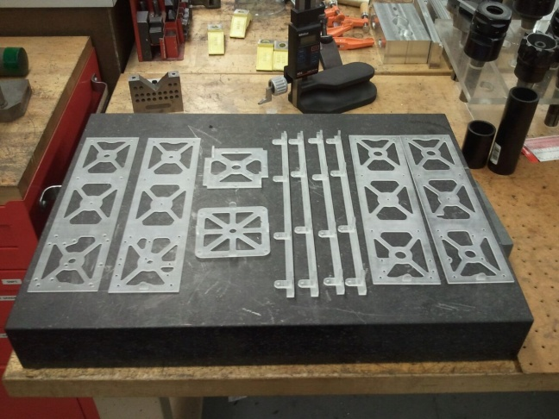
Overcoming Engineering Challenges on SDS-1
Building a satellite can be a difficult logistics and engineering problem
Split up team into subsystems
Electrical Power Subsystem
Andrew Menicosy, Jimmy Nguyen
Communication Subsystem
Robert Bui
Attitude Controls Subsystem
Michelle Smith
Utilized NASA systems engineering approach
Design reviews, etc…
Much of the team worked “pro-bono”
Many pieces of critical analysis software were donated
In the end, the SDS-1 had an “easy” time with engineering…
Funding is more like rocket science than rocket science is

Slide 6
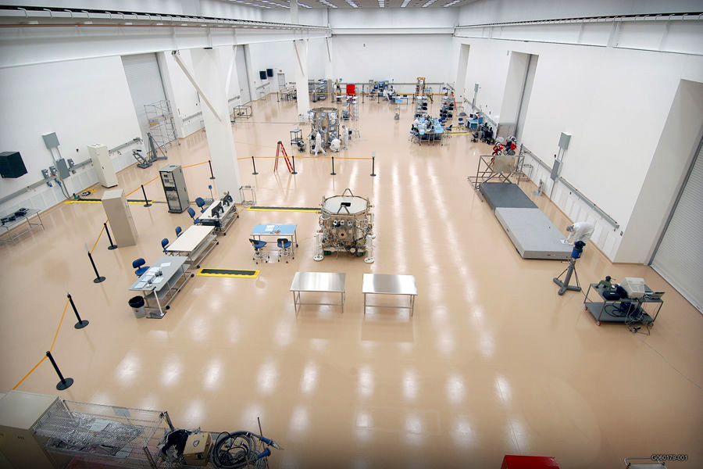

Approaching the Funding Problem
Budget for SDS-1:
$98,000.00
The satellite hardware is expensive
Corporate donations are difficult to obtain
Ideally a satellite could be built with all donated hardware from private enterprise
SDS-1 mission is too specified to stray from its hardware design choices
Crowd-funding
Websites like kickstarter…
Great for lower budget, practical and immediate engineering projects
Research grants
Grants from NSF would be ideal
Usually low number of grants given out

Slide 7
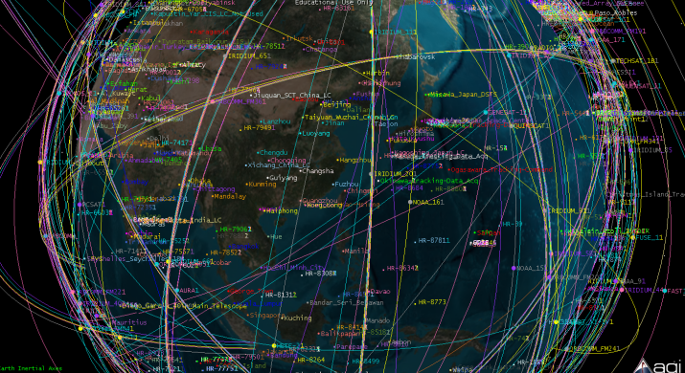
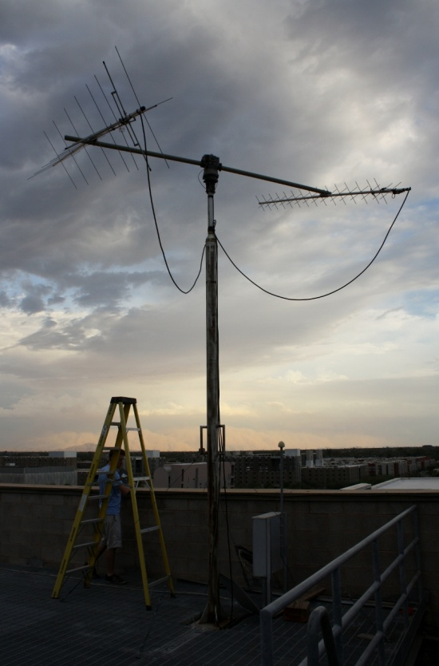
Summary and Current Status
SDS-1 at ~90% through critical design
Funding at ~10% of hardware costs
ASU and industry support gaining momentum
Tremendous software donations made
ASU donated class 1000 clean room
Also donated yagi antenna ground station
Primary problem is funding
Pursuing federal and commercial research grants
Reaching out for corporate donations

Slide 8
Questions or Comments?
Name: Aaron Goldstein
Website: http://sdsl.club.asu.edu/
Email: sdsl@asu.edu
or aaronmgoldstein@gmail.com

